Slide 1
Milestone 2 Group 1 SEC 101
Gabriele Chiossi, Ben Marschall, Si'raaj Woods

Slide 2
Technology Stack and Tool Chain
We have been using VSCode, Xcode, and Sublime Text to edit all our files. As well as a browser to look at the changes that we put in our code.
We use Github more frequently this milestone because we had some good code ready to be pushed and also created a new version (currently V3.0)

Slide 3
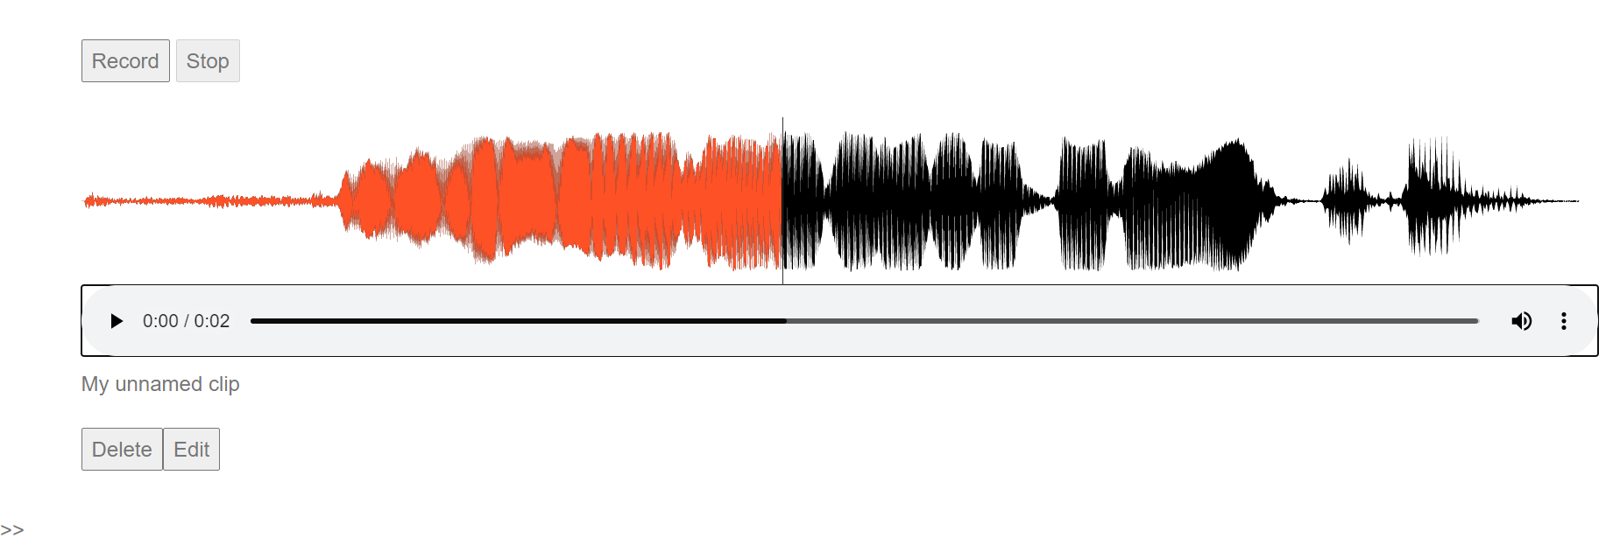
Individual Responsibilities of All Members
Gabriele has fixed the stream now the stream is on only when we are recording, and it is flat when we are doing anything else. Also develop part of the new music player, I used the API wavesurfer for our wave form in the sounds, it has a few bugs but hopefully they will be fixed by the next milestone

Slide 4
Technology/Device Access of all Members
We have a lot of different technological devices that we have access to. We have been using all of the devices below to get the system to work on multiple platforms.
MACOS
WINDOWS OS
LINUX OS
TEAMS (to comunicate via videocall)
iMessage (to chat daily and update the team)
Browsers: Chrome and Firefox mainly

Slide 5
Definition of the Next Milestones
Fixes all the bugs that we have and hopefully and a fair understanding of this new language

Slide 6
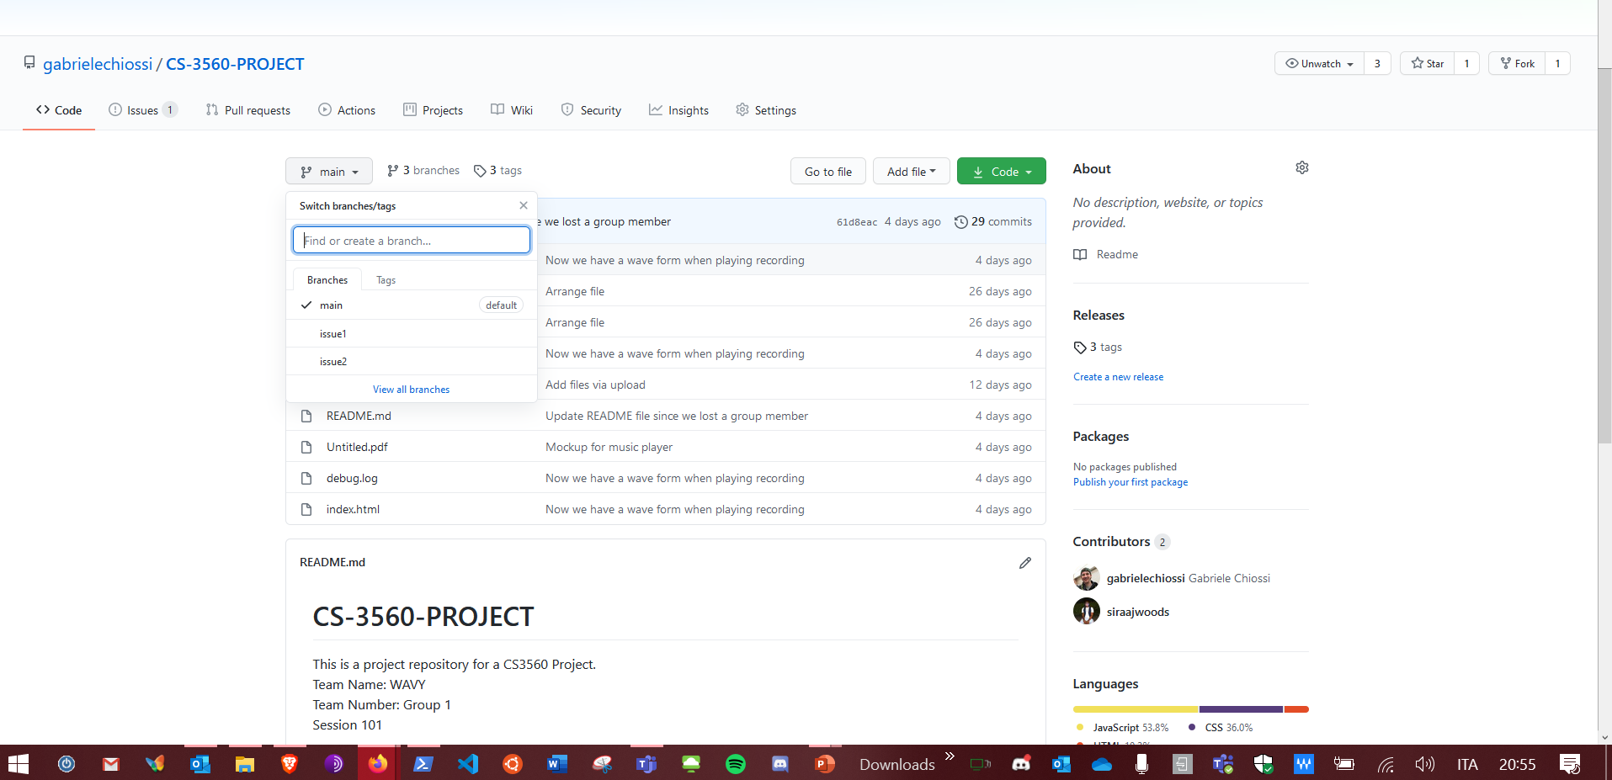
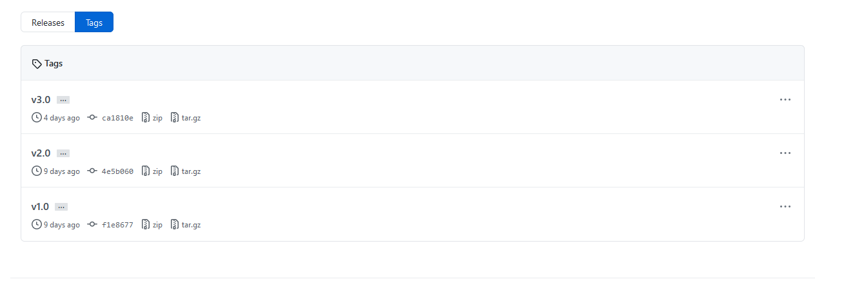
A walk-through of the git repo

Slide 7
Team Communication Plan and Workflow, Including The Two Time Slots For Potential Team Meetings
We communicate very often via text messages for easy communication. However, we also FaceTime and use Microsoft Teams for some of the bigger issues and to keep eachother updated on vital information.
We meet at least twice a week, Tuesday and Thursday night usually after class time, if synchronous, or during class time if asynchronous. We also sometimes meet on the weekends on either Saturdays or Sundays.
Everything that we add we make sure that it works correctly, and have the team agree on it before it is pushed to GitHub.

